Slide 1

DS310 Project
Gabrielle Thompson, Katherine Beaty, Primah Muwanga, Ruxin Wen

Slide 2
01
Introduction
Our goals, process, dataflow/pipelines

Slide 3
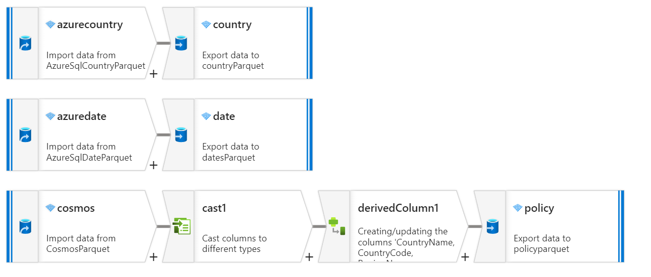
Show dataflows here
Maintains a high-level introduction to your data flow

Slide 4
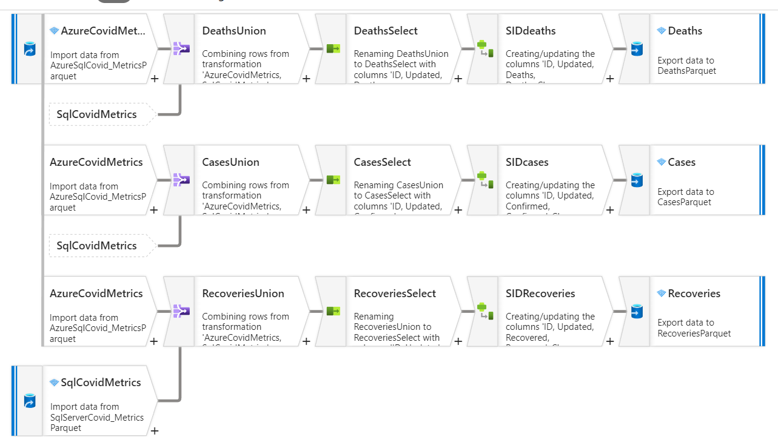
DATA FLOW CONTINUED
Notes:
KB

Slide 5
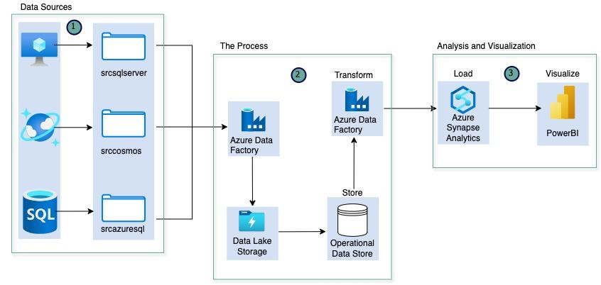
Architecture Diagram

Slide 6
02
Statistical Process
What we did to get to our solution

Slide 7
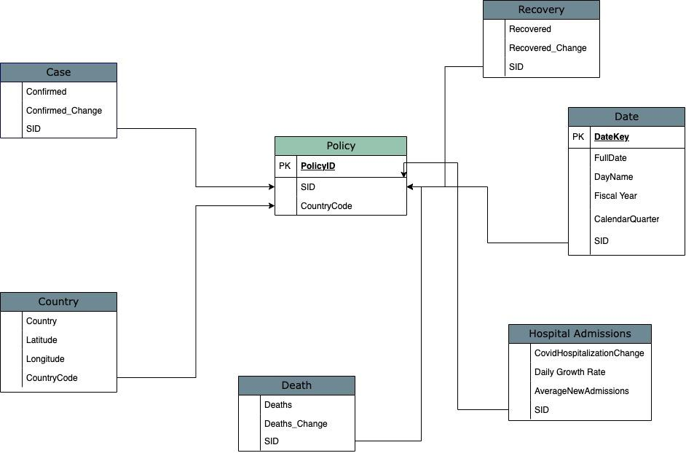
Schema

Slide 8
What statistics did we use
30 Day Rolling Average
…measure that counted how long the data spanned
…Measure that tracked number of active days

Slide 9
03
PowerBI Analysis
The results of our research

Slide 10
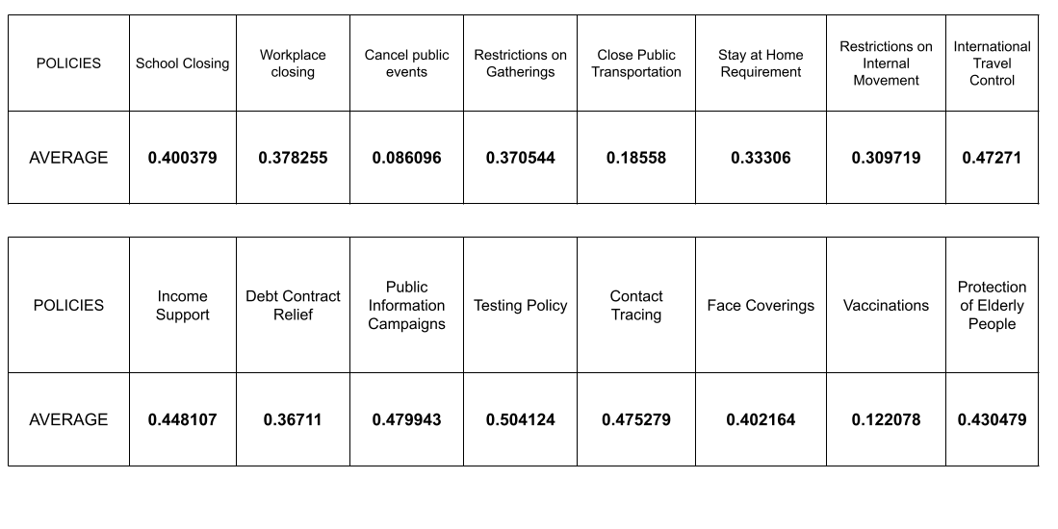
Results

Slide 11
04
Final Thoughts
The conclusion

Slide 12
Overview of Recommendations
Best Policy
TESTING POLICY
Second Best | Third Best
PUBLIC INFORMATION CAMPAIGNS | CONTACT TRACING

